Slide 1

Gesture Recognition Reading Muscle Activity
Project Phase 3 - Dimensionality Reduction, Clustering and Evaluation
DS5230 / Spring 2024 Semester
Team Members: Liyang Song
Apr 20, 2024

Slide 2
Reproducibility
All works are completed within Jupyter Notebooks and have been fully executed.
To reproduce:
Download the environment.yml and recreate project_venv conda environment.
Download supported python modules.
processing.py
clustering.py
validation.py
Download Jupyter Notebooks.
project_phase_3_clustering_pipeline.ipynb
project_phase_3_optimization.ipynb (takes super long time to execute)
project_phase_3_afd.ipynb (takes long time to execute)
project_phase_3_validation.ipynb
Open notebooks in browser, click restart the kernel and rerun all cells button to reproduce all works.
HTML versions of the fully executed Jupyter Notebooks have also been provided.

Slide 3
Clustering Pipeline
Original Data Set
Design Data Set
Preprocessor
Embedding of UMAP
UMAP Find-tuning
Results
Split
K-Means Internal Indices
Target Data Set
Passed
K-Means
Result Tests
K-Means
Not
Passed
External Indices
DBSCAN Internal Indices
Best Clustering Result
DBSCAN

Slide 4
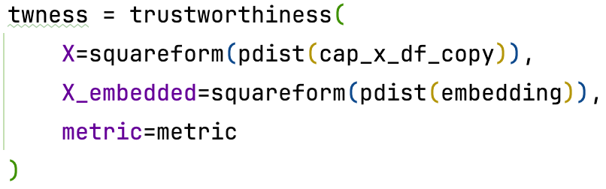
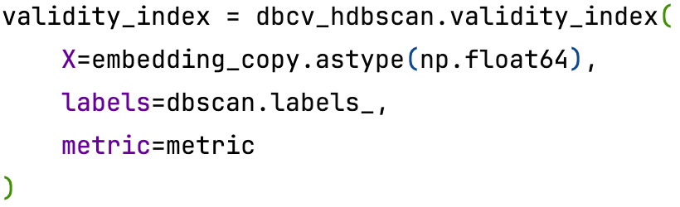
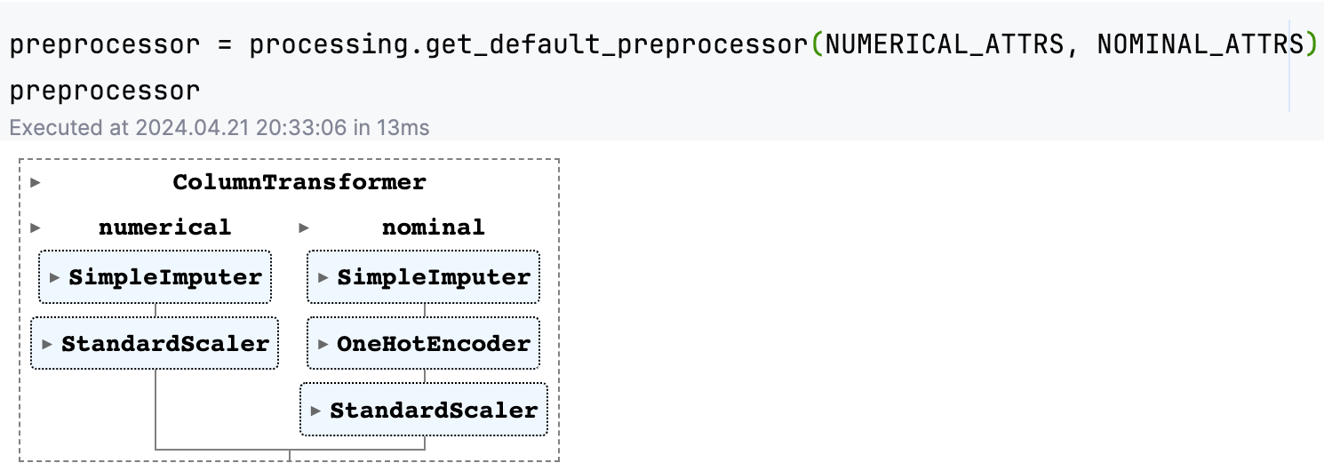
Clustering Pipeline: Updates
This part extends the clustering pipeline from assignment_4 and the midterm exam, with some errors fixed:
The metric parameter of Trustworthiness is now the same as UMAP.
The metric parameter of Validity Index is now the same as DBSCAN.
Preprocessors such as imputers and scalers are added.

Slide 5
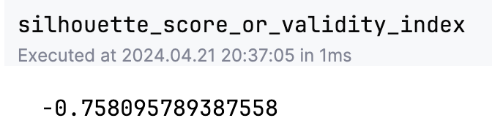
Clustering Pipeline: Default Result
In the pipeline notebook, we tested the clustering with all default parameters of UMAP and K-means algorithm. This result is clearly not good, but it can at least be used as a baseline for the following pipeline optimization and validation.

Slide 6
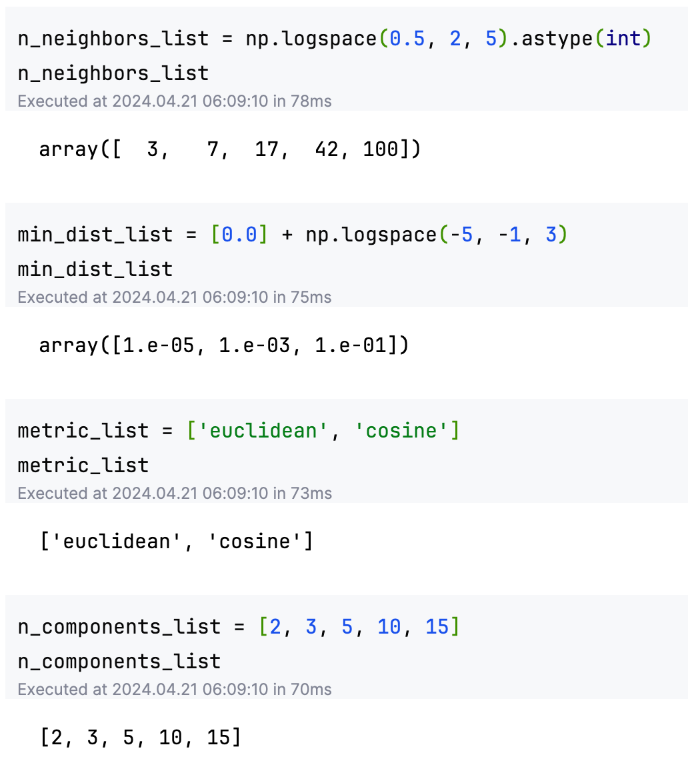
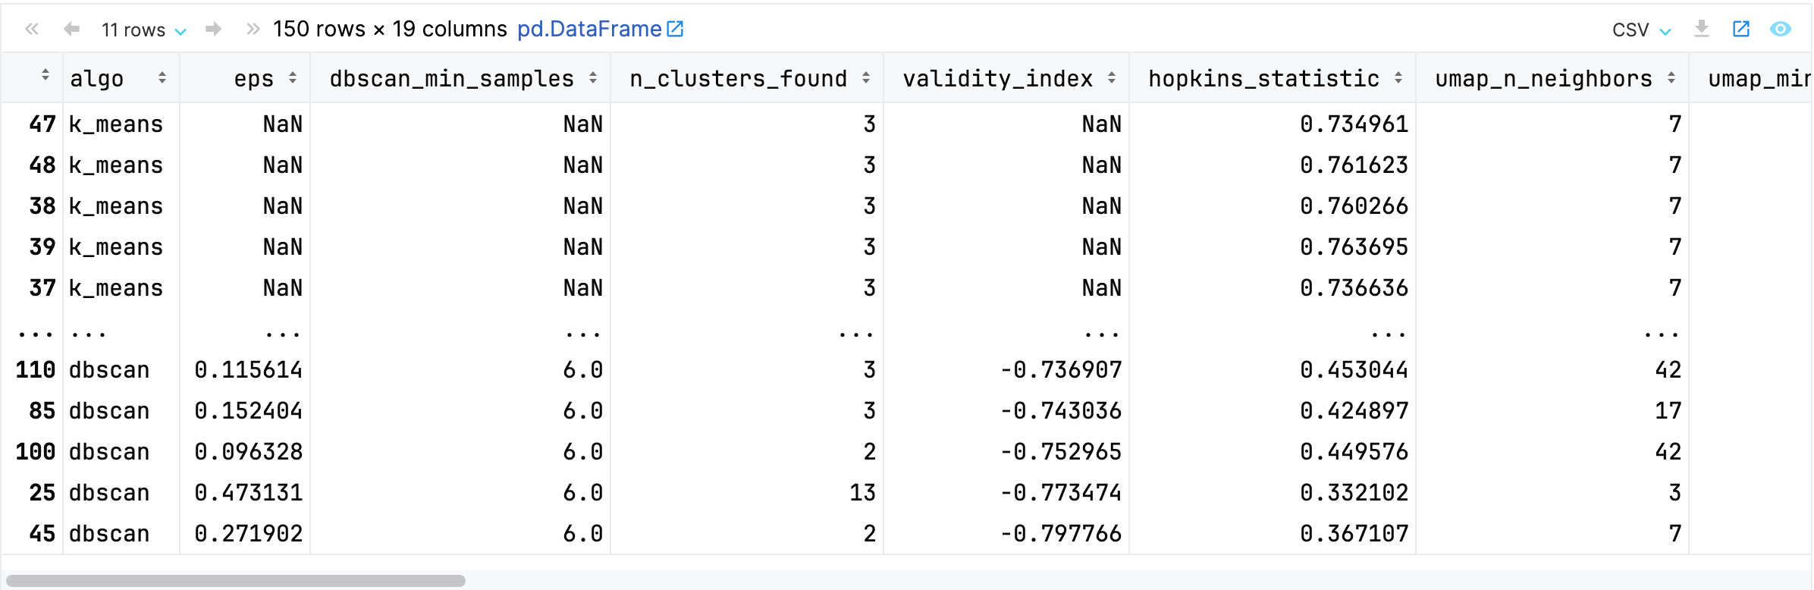
Clustering Pipeline Optimization: Hyperparameters
The pipeline optimization refers to fine-tuning hyperparameters of UMAP, including several important parameters like n_neighbors_list, min_dist_list, metric_list, and n_components_list.
We first tested a small proportion of the grid search space, to have an idea of the time consumption. It showed one hyperparameter combination takes around 3 - 5 minutes. We decided to explore a grid search space with 150 combinations, and it finally spent around 350 minutes.

Slide 7
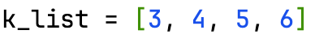
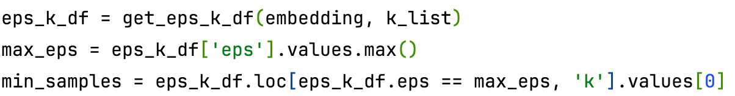
Clustering Pipeline Optimization: Hyperparameters (continued)
Some hyperparameters of K-Means and DBSCAN were also tuned during the optimization process.
n_clusters of K-Means
eps of DBSCAN
min_samples of DBSCAN
metric of DBSCAN

Slide 8
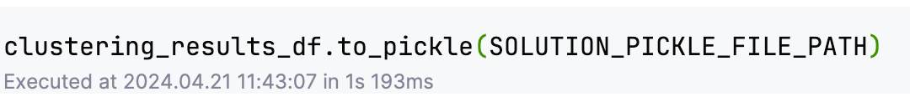
Clustering Pipeline Optimization: Results
Internal indices are used to select the best results during the pipeline optimization, includes:
Silhouette Score of K_Means
Validity Index of DBSCAN
The result of pipeline optimization is a DataFrame of shape (150, 19), including hyperparameter combinations, their resulting internal indices, UMAP embeddings, and fitted models.
It was saved into an optimization_results.pkl file for the access of the following False Discovery Checking and Validation processes.

Slide 9
Avoid False Discovery: Internal Indices Distribution
As the optimization takes quite a long time, we put all results analysis and false discovery checking content in the afd notebook.
Among the 150 clustering results, we put the silhouette_score of K_means and validity_index of DBSCAN together as the rank of results.
1 means best clustering
0 means overlapping clusters
-1 means worst clustering
The distribution of silhouette_score or validity_index among the 150 results shows that K_means performs better than DBSCAN in general. And most DBSCAN have negative validity indices.

Slide 10
Avoid False Discovery: Latent Manifold Details
The best result was chosen as the Latent Manifold and here is the hyperparameters and internal indices:
number of classes in data set | UMAP n_components | UMAP min_dist | UMAP n_neighbors | UMAP metric | trustworthiness | clustering algorithm | number of clusters found | validity index or silhouette score
4 | 5 | 0.001 | 7 | cosine | 0.823645 | k_means | 3 | 0.549104
It shows the highest validity_index or silhouette_score is 0.55, which is not very high. We will discuss this in detail in the validation part.

Slide 11
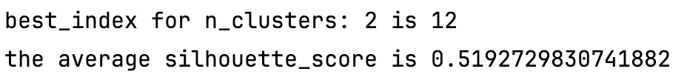
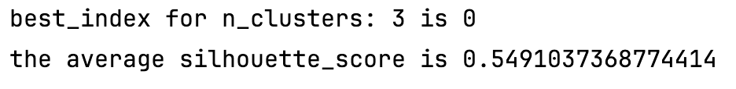
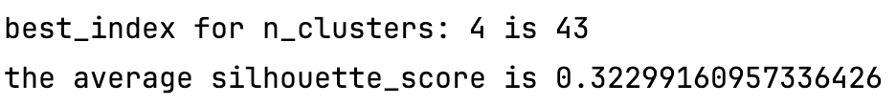
Avoid False Discovery: Silhouette Analysis
Although we have chosen the latent manifold with the highest silhouette_score, we also did some exploration using the silhouette_score plots.
Among the 150 clustering results, all ones using k_means algorithm have the following n_clusters_found: 2, 3, and 4. For each of them, we select the best one result with the highest silhouette_score to analyze.

Slide 12
Avoid False Discovery: Silhouette Analysis (continued)
The 3 silhouette_score plots show that although n_clusters=3 has the highest silhouette_score, n_clusters=2 and n_clusters=4 also have some meaningful results.
Width of the silhouette plot (y-axis) represents the number of points in each cluster. A wider silhouette indicates more points in the cluster.
Height of the silhouette plot (x-axis) represents the silhouette score. A silhouette that reaches closer to 1 indicates better clustering.
The red dashed line represents the average silhouette score across all samples. The closer the silhouette's height is to this line (or beyond), the better it is considered for the clustering.
Although n_clusters=3 has the highest overall average silhouette score, indicating better average separation and cohesion, n_clusters=2 and n_clusters=4 also show that the additional clusters' silhouettes are above the average line. This means the existence of one extra cluster doesn't deteriorate the overall structure, and the additional clusters also hold statistically meaningful cohesion and separation.

Slide 13
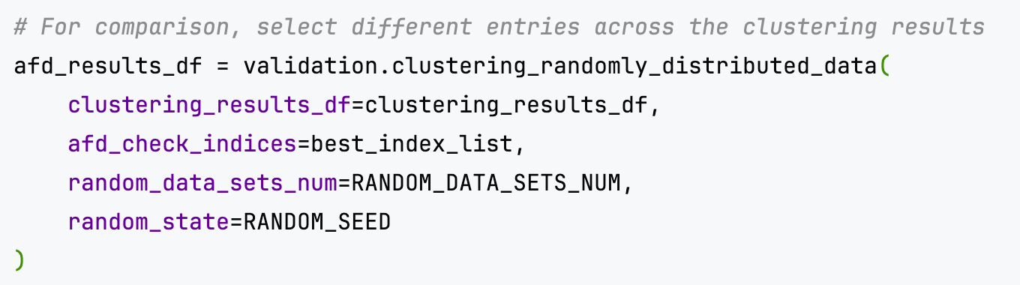
Avoid False Discovery: Checking Sets
Although we choose silhouette_score as the standard to rank clustering results, other clustering results may also be meaningful. Thus, in the False Discovery Checking part, we continue to check false discoveries for all the above 3 clustering results.
For each clustering result, we use its UMAP embedding to generate randomly distributed data sets, and calculate their silhouette scores. For a true discovery, its silhouette score should separate clearly from those of randomly distributed data sets.
The number of generated random sets (random_data_sets_num) can be declared and assigned to the AFD function. Also, we use one parameter afd_check_indices to determine which indices we are going to check. (here is the 3 results above)

Slide 14
Avoid False Discovery: Checking Results
The false discovery checking results are shown in the 3 plots below. It shows that both n_clusters=2 and n_clusters=3 have a good separation with random data sets, while n_cluters=4 has much overlapped with random sets.
Considering the high silhouette score, it seems n_clusters=3 is a good clustering result.

Slide 15
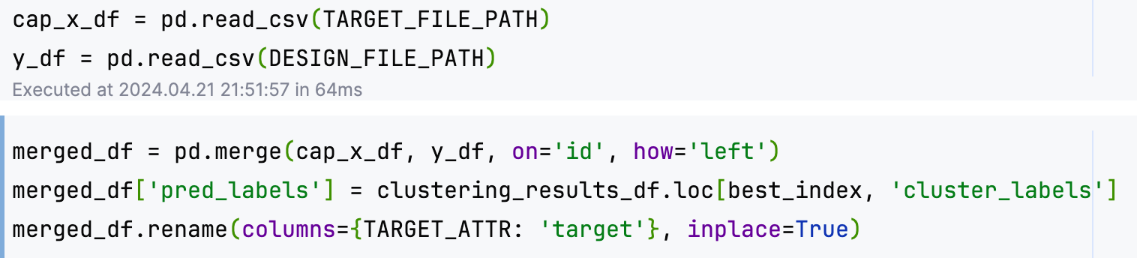
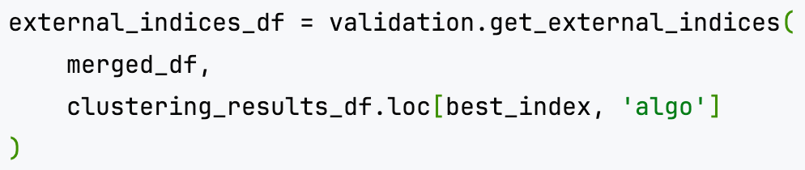
Clustering Validation: External Indices
In this part, we read back the pre-separated target file and design file in project phase 1, merge them back by id, add the predicted label from the best clustering result (the latent manifold), and calculate its external indices.
rand_score: [0, 1], 1 means perfect clustering
adjusted_rand_score: [-1, 1], 1 means perfect clustering
fowlkes_mallows_score: [0, 1], 1 means perfect clustering
normalized_mutual_info_score: [0, 1], 1 means perfect clustering
jaccard_score: scores for each label. [0, 1], 1 means perfect clustering
f1_score: scores for each label. [0, 1], 1 means perfect clustering
purity_score: [0, 1], 1 means perfect clustering
contingency_matrix

Slide 16
Clustering Validation: External Indices Results
The external indices results and the contingency matrix are generated in a data frame, they are also shown in the below table and the matrix plot.
rand_score | adjusted_rand_score | fowlkes_mallows_score | normalized_mutual_info_score
0.691157 | 0.335773 | 0.565941 | 0.436435
jaccard_score | f1_score | purity_score
[0.02312381753205802, 0.0024316109422492403, 0.010894394658232297, 0.0] | [0.04520238339839737, 0.0048514251061249234, 0.021553971840778726, 0.0] | 0.601045

Slide 17
Discussion of Performance
The number of clusters in our result (3) is different from the true number of classes (4). Specifically, the class 3 is not recognized and is mixed up with cluster 1.
The external indices show some relatively good results, but not that good enough due to the different number of clusters with the true label numbers. Notice that jaccard_score and f1_score are label-based, which shows 0 score for the missing label.
As the time limit, we can only perform current hyperparameter searching and get our current best result. For future research, maybe a broader search space, or different algorithms such as deep learnings can be applied to improve the performance.

